Slide 1
Aspect-oriented programming
Ruben te Wierik
21st of October, 2022

Slide 2
Contents
What is aspect-oriented programming?
Examples using Spring AOP
Example using AspectJ and Kotlin
Weaving
Spring AOP vs. AspectJ

Slide 3
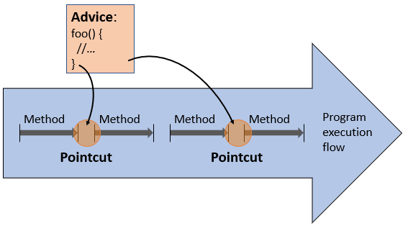
What is aspect-oriented programming?
Advice: the method which implements some common task like logging or caching
Pointcut: a pattern expression which matches the places where your Advice should be invoked
Aspect: The Advice plus the Pointcut expression
Join point: All places in your code that represent candidates for a Pointcut
Logging
Monitoring
Auditing
Security
Caching

Slide 4
Examples using Spring AOP
@Cacheable: a standard Spring Advice
FibonacciService
WebController
Log REST calls with a custom Aspect
Performance monitoring with AOP
Retry mechanism with AOP

Slide 5
Example using AspectJ and Kotlin
Demo time!

Slide 6
Weaving
Both AspectJ and Spring AOP use a different type of weaving which affects their behavior regarding performance and ease of use.
AspectJ makes use of three different types of weaving:
Compile-time weaving: The AspectJ compiler takes as input both the source code of the aspects and the application and produces woven class files as output.
Post-compile weaving: This is also known as binary weaving. It is used to weave existing class files and JAR files with the aspects.
Load-time weaving: This is exactly like the former binary weaving, with a difference that weaving is postponed until a class loader loads the class files to the JVM.

Slide 7
Spring AOP vs. AspectJ
Spring AOP
It is not intended as a complete AOP solution – it can only be applied to beans that are managed by a Spring container.
It makes use of runtime weaving.
It is a proxy-based AOP framework. This means that to implement aspects to the target objects, it’ll create proxies of that object.
It is much slower than AspectJ.
It is easy to learn and apply.
AspectJ
AspectJ is the original AOP technology that aims to provide a complete AOP solution.
It makes use of three different types of weaving: compile-time weaving, post-compile weaving, load-time weaving.
Nothing is done at runtime as the classes are compiled directly with aspects.
It has better performance.
It is more complicated than Spring AOP.
An additional note: If performance under high load is important, you'll want AspectJ which is 9-35x faster than Spring AOP. Some projects use lots of aspects (~10.000) in which case a request might hit thousands of aspects and the execution time of each of these aspects is added to the response time of the request.
See the benchmarks.

Slide 8
Additional remarks
Joinpoint | Spring AOP Supported | AspectJ Supported
Method Call | No | Yes
Method Execution | Yes | Yes
Constructor Call | No | Yes
Constructor Execution | No | Yes
Static initializer execution | No | Yes
Object initialization | No | Yes
Field reference | No | Yes
Field assignment | No | Yes
Handler execution | No | Yes
Advice execution | No | Yes
It's also worth noting that in Spring AOP, aspects aren't applied to the method called within the same class.
When a method is called within the same class, then the method of the proxy that Spring AOP supplies is not called. If this functionality is required, a separate method in a different bean has to be defined, or AspectJ should be used.

Slide 9
Sources
Intro to AspectJ | Baeldung
Spring Boot - Difference between AOP and AspectJ
Learn Aspect Oriented Programming by Example
Introduction to Spring AOP
Spring AOP vs. AspectJ
Freefair’s AspectJ examples for Gradle
Spring AOP & AspectJ Benchmarks

